Slide 1
Sinusoidal Steady-State
Power Calculations
Textbook:
Electric Circuits
James W. Nilsson & Susan A. Riedel
9th Edition.

Slide 2
Outline
Instantaneous power
Average (real) power
Reactive power
Power in purely resistive, inductive and capacitive circuits
Power factor and reactive factor
Complex power and apparent power
Maximum power transfer

Slide 3

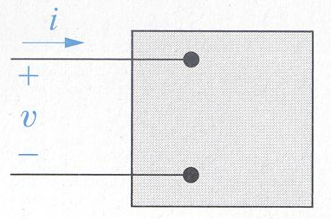
Instantaneous Power
Instantaneous power is the product of the instantaneous terminal voltage and current.
The positive sign is used when the reference direction for the current is from the positive to the negative reference polarity of the voltage.
Instantaneous power is measured in watts when the voltage is in volts and current is in amperes.

Slide 4
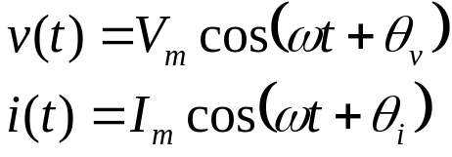
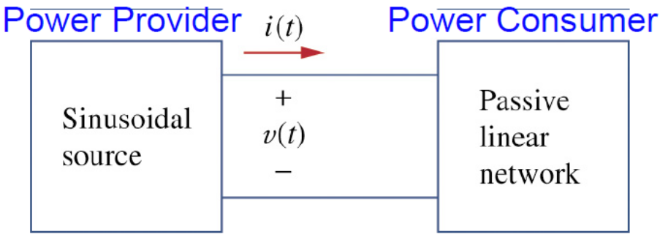
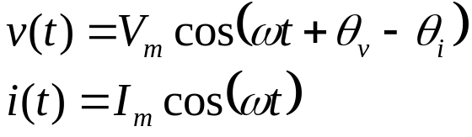

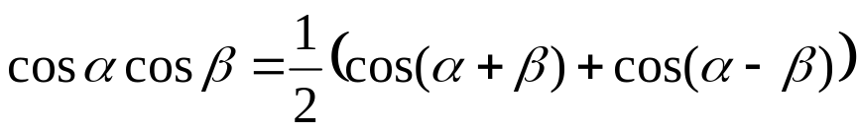
Instantaneous Power
Given:
Choose convenient reference for zero time:
Instantaneous power is calculated by:
Expanded formula:

Slide 5
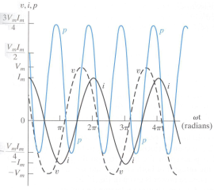
Instantaneous Power
The frequency of the instantaneous power is twice the frequency of the voltage (or current).
Instantaneous power may be negative for a portion of each cycle
Instantaneous power, voltage and current versus ωt for steady-state sinusoidal operation (θ_{v} = 60° and θ_{i} = 0° )

Slide 6

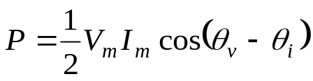
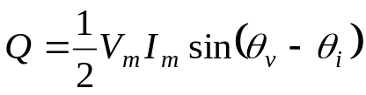
Average and Reactive Power
Instantaneous power:
Instantaneous power is rewrite as follow:
Average power:
Reactive power:

Slide 7
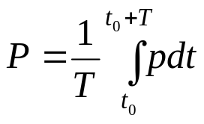
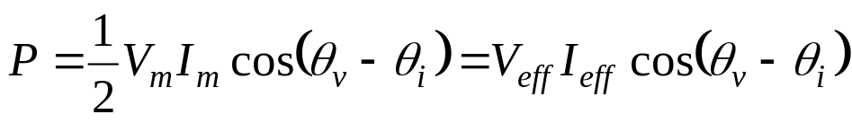
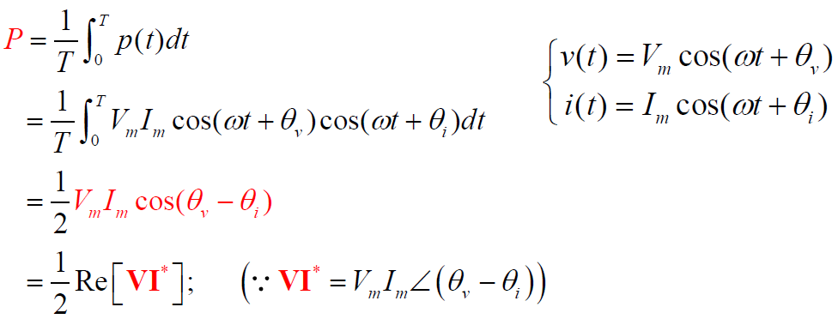
Average (Real) Power
Average power is the average value of the instantaneous power over one period.
Average power is expressed as:
Average power is also called real power because it describes the power in a circuit that is transformed from electric to nonelectric energy.

Slide 8
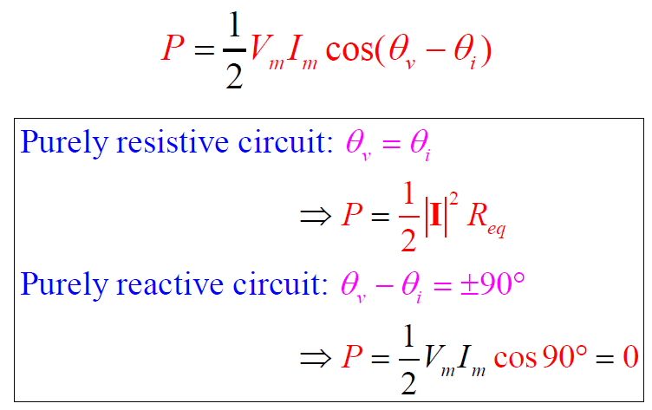
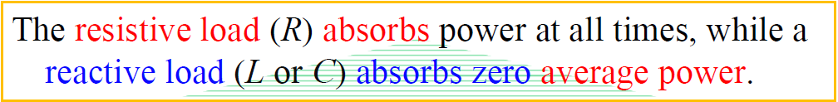
Average (Real) Power
Two Special Cases of Average Power

Slide 9
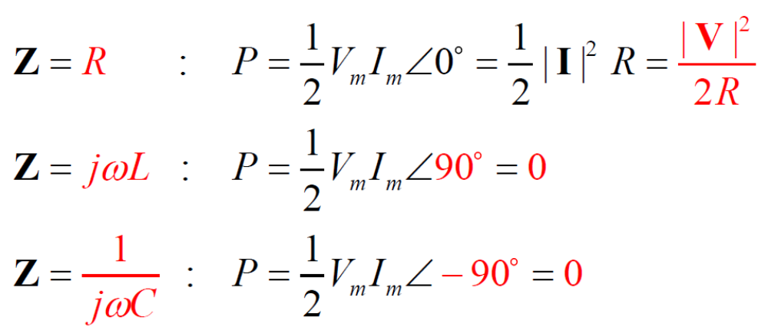
Average (Real) Power
Two Special Cases of Average Power

Slide 10
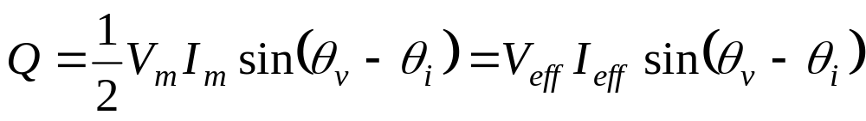
Reactive Power
Reactive power is the electric power exchanged between the magnetic field of an inductor and the source that drives it or between the electric field of a capacitor and the source that drives it.
Reactive power is never converted to non-electric power.
Reactive power is expressed as:
Both average power and reactive power can be expressed in terms of either peak (V_{m},I_{m}) or effective (V_{eff} , I_{eff}) current and voltage.
Effective values are widely used in both household and industrial application.
Effective value and rms value are interchangeable for the same value.

Slide 11
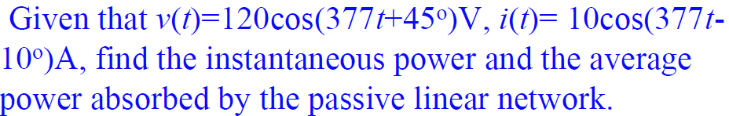
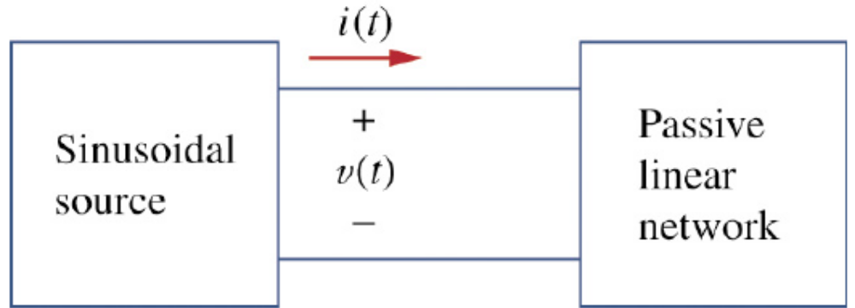
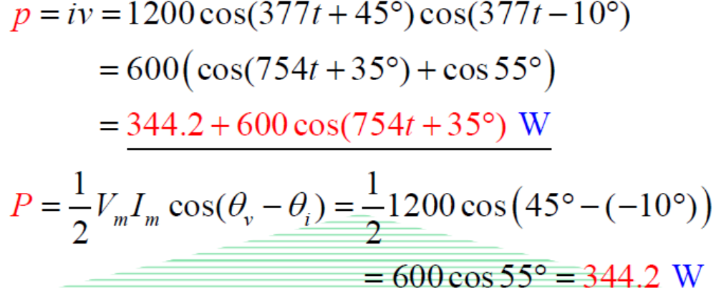
Example 1.

Slide 12
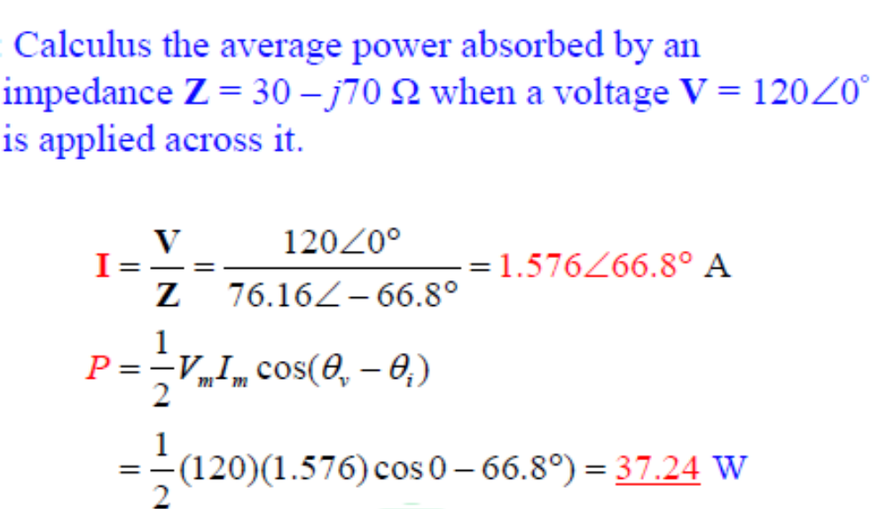
Example 2.

Slide 13
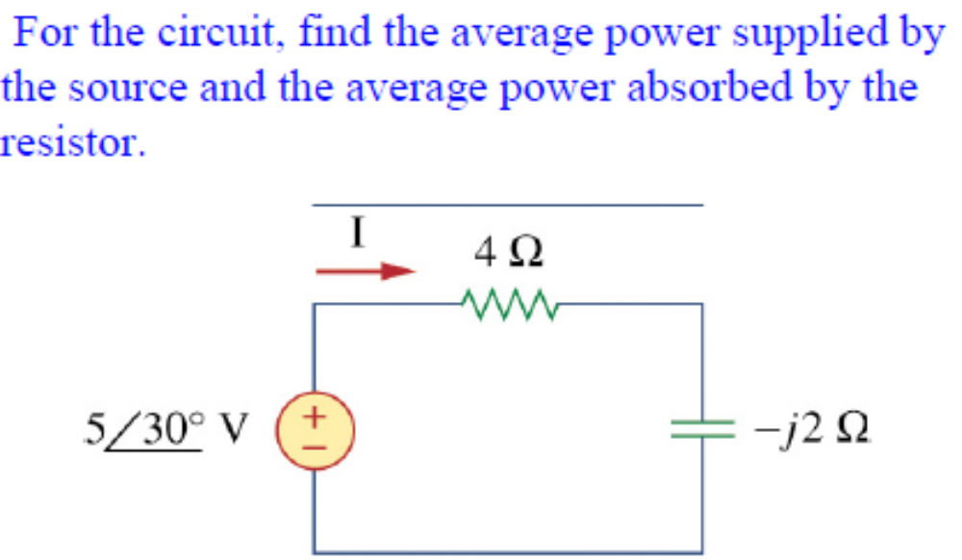
Example 3.

Slide 14
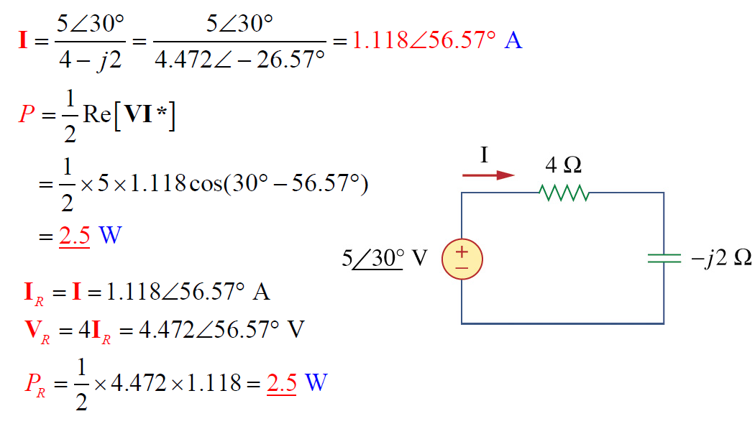
Example 3 - Solution

Slide 15
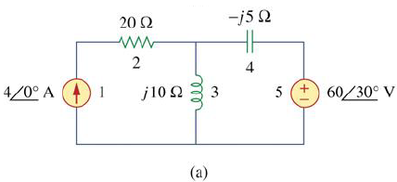
Example 4
Determine the average power generated by each source and the average power absorbed by each passive element in circuit (a).

Slide 16
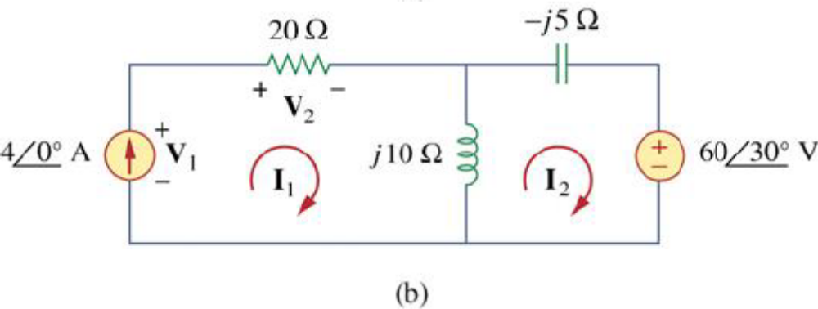
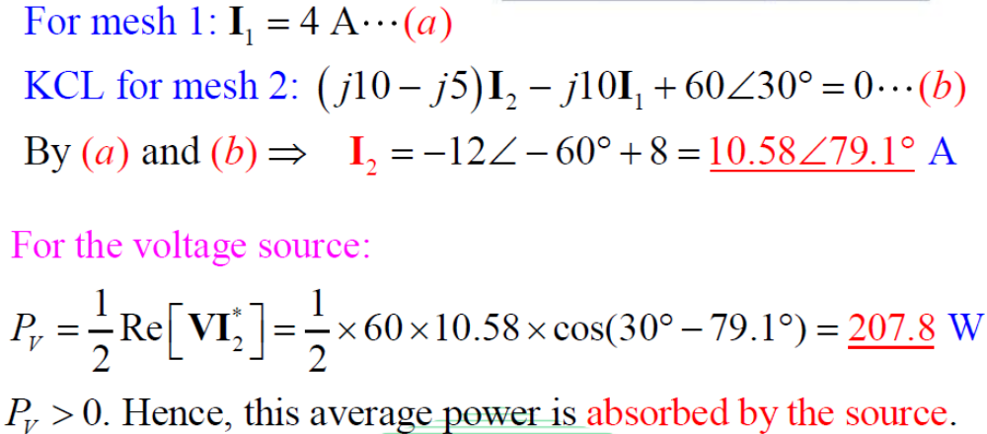
Example 4 - Solution

Slide 17
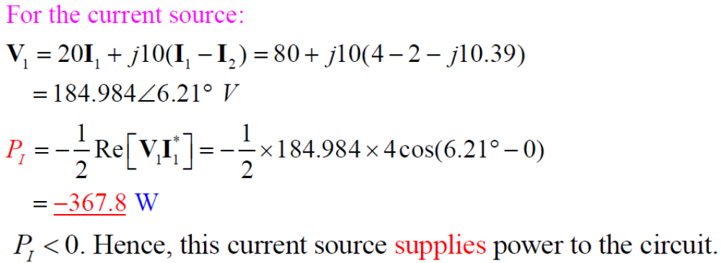
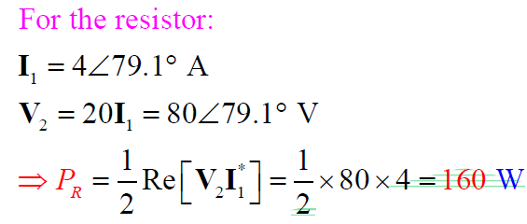
Example 4 - Solution

Slide 18
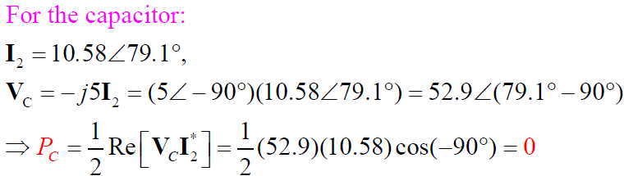
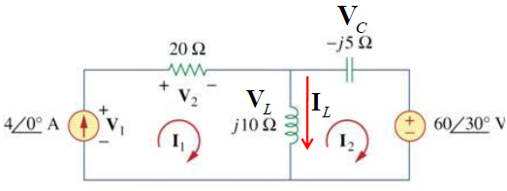
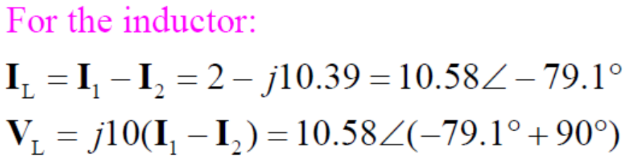

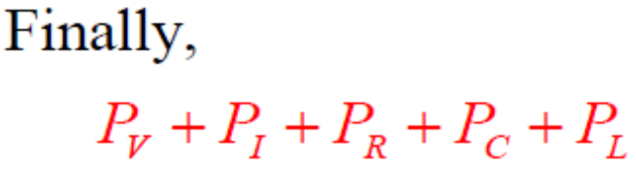
Example 4 - Solution

Slide 19
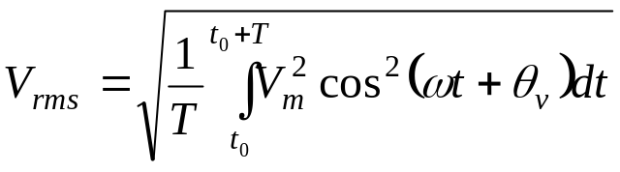
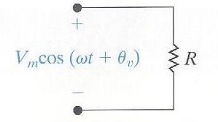
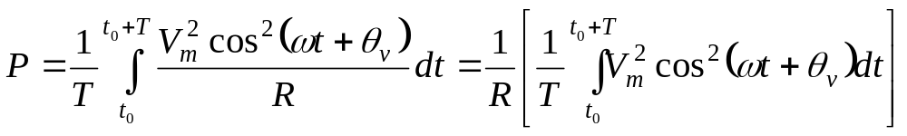
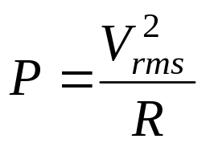
The rms value and power calculation
Definition of V_{rms} :
Average power delivered to the resistor:
It can be seen that the average power delivered to R is simply the rms value of the voltage squared divided by R.

Slide 20
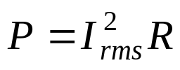
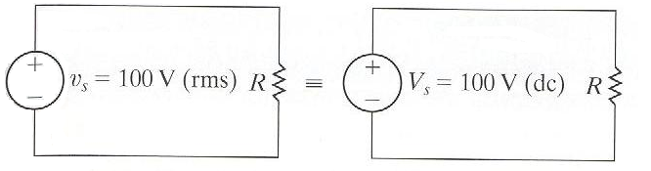
The rms value and power calculation
If the resistor is carrying a sinusoidal current, then average power delivered to the resistor is:
The rms value is also referred to as the effective value of the sinusoidal voltage (or current).
The rms value of a sinusoidal source delivers the same energy to R as does a dc source of the same value. Energywise, the effect of the two sources is identical. Therefore, the term effective value being used interchangeable with rms value.

Slide 21


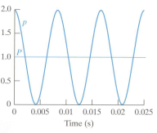
Power for Purely Resistive Circuits
In purely resistive circuits, the voltage and current are in phase
The instantaneous becomes:
The instantaneous power in purely resistive circuits is always positive.
Or, power cannot be extracted form a purely resistive network.
Instantaneous and average powers (W)

Slide 22


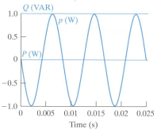
Power for Purely Inductive Circuits
In purely inductive circuits, the voltage leads the current by 90º :
The instantaneous becomes:
In a purely inductive circuit:
Average power is zero. Therefore, no transformation of energy form electric to nonelectric form takes place.
The instantaneous power is continually exchanged between the circuit and the source driving the circuit at 2ω frequency. When p>0, energy is being stored in the magnetic fields associated with the inductive elements. When p <0, energy is being extracted from the magnetic fields.
Reactive power is named from the characterization of an inductor as a reactive element.
The unit of reactive power is var
Instantaneous, average and reactive powers for a purely inductive circuit

Slide 23


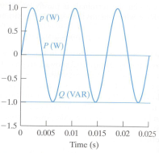
Power for Purely Capacitive Circuits
In purely capacitive circuits, the voltage lags the current by 90º :
The instantaneous becomes:
In a purely capacitive circuit:
Average power is zero. Therefore, no transformation of energy form electric to nonelectric form takes place.
The instantaneous power is continually exchanged between the electric field associated with the capacitive elements and the source driving the circuit at 2ω frequency.
Depend on the algebraic sign of Q, it can be said that inductors absorb magnetizing vars, and capacitors deliver magnetizing vars.
Instantaneous, average and reactive powers for a purely capacitive circuit

Slide 24


Power Factor and Reactive Factor
The power factor is the cosine of the phase angle between the voltage and the current
The reactive factor is the sine of the phase angle between the voltage and the current.
Lagging power factor implies that the current lags voltage – hence an inductive load.
Leading power factor implies that the current leads the voltage – hence a capacitive load.

Slide 25

Complex Power
Complex power is the complex sum of the real and reactive powers
The watt is used as the unit for both instantaneous and real power.
The var (volt ampere reactive, or VAR) is used as the unit for reactive power.
The volt-amp (VA) is used as the unit for complex and apparent power.

Slide 26
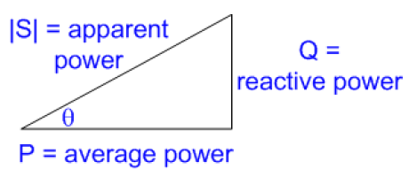

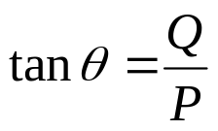
Apparent Power
The geometric relations mean that four power triangle dimensions (the three sides and the power factor angle) can be determined if any two of the four are known.
Power triangle
Apparent power is the magnitude of the complex power:
The angle θ in the power triangle is the power factor angle θ_{v} – θ_{i} :

Slide 27
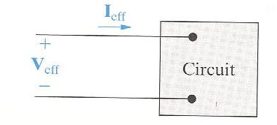
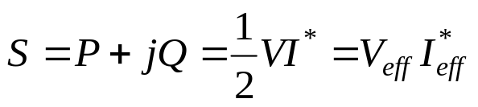
Power Calculation
Complex power:
Can you prove it?

Slide 28
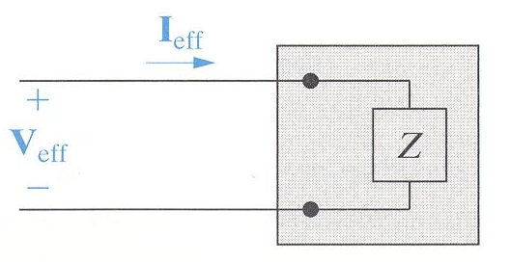
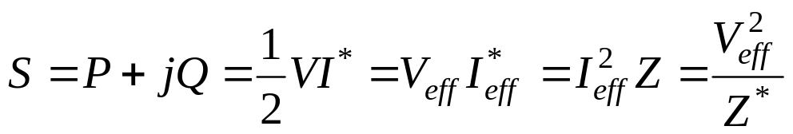
Alternate form for complex power
Can you prove it?

Slide 29
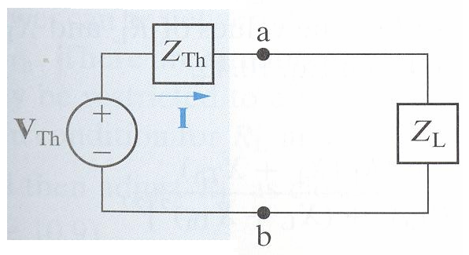
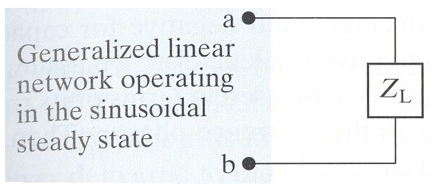
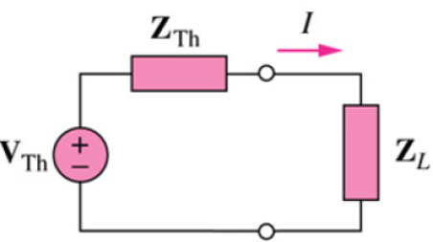
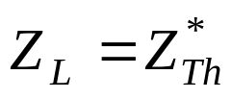
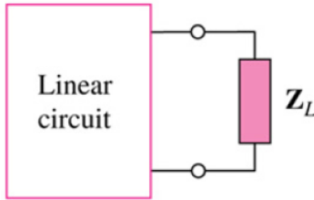

Maximum Power Transfer
Maximum power transfer occurs in circuits operating in the sinusoidal steady state when the load impedance is the conjugate on the Thevenin impedance as viewed from the terminals of the load impedance.
Maximum average power absorbed:
8

Slide 30

Maximum Power Transfer
Derivation of Maximum Average Power Transfer

Slide 31

Maximum Power Transfer
Derivation of Maximum Average Power Transfer

